Slide 1


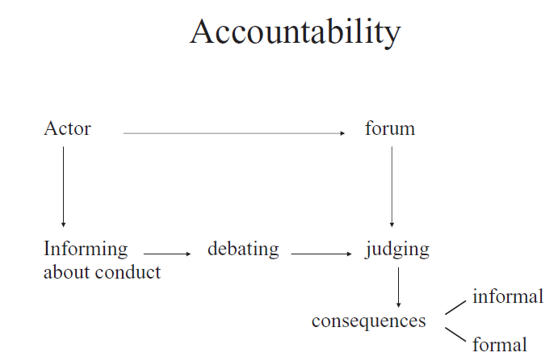


Accountability and social media
Study 1
Study 2
Accountability!
Openness
Responsiveness
Topic diversity
Expectation of

